Slide 1
Analyzing Major League Baseball Using XMT Architecture
April 22, 2014
Vince Gennaro
Society for American Baseball Research

Slide 2
Agenda
The Changing World of Baseball Information and Data
Big Data Application
Using XMT architecture to predict the outcome of the batter-pitcher matchup

Slide 3
A New Era of Baseball Analytics
Proliferation of baseball data
Revolutionary processing technology
Massive, inexpensive storage capability

Slide 4
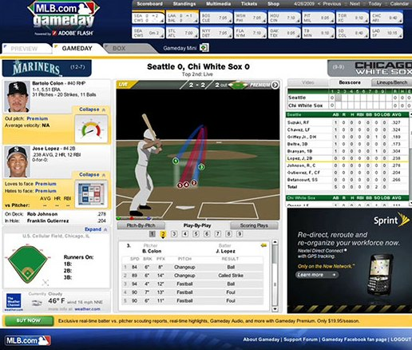
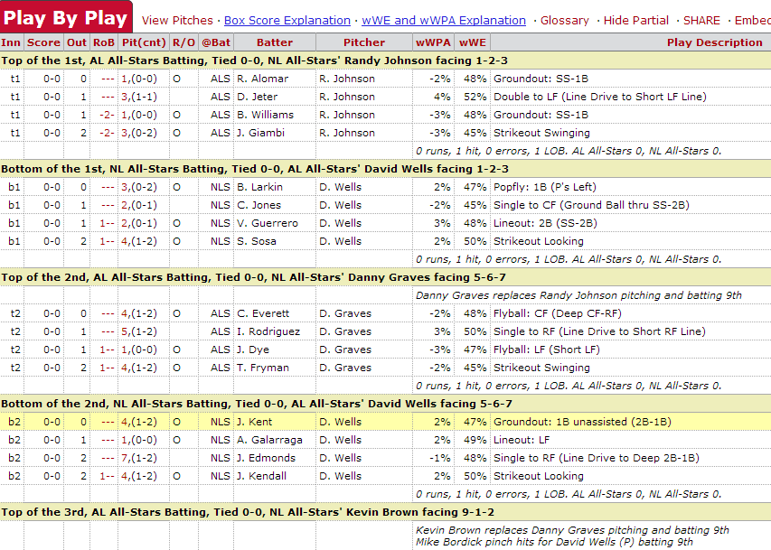
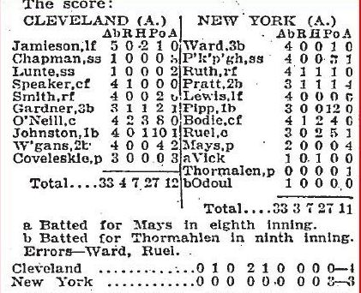
Our World Has Changed
Play-by-Play
Box Score
Pitchf/x
Source: MLB.com and Baseball-Reference

Slide 5
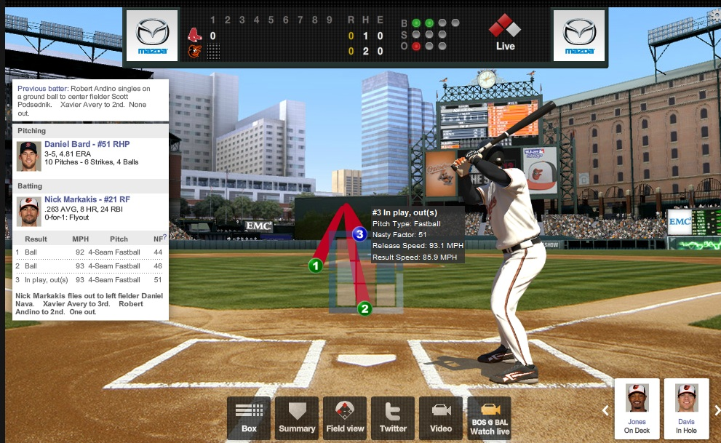
Our World Has Changed

Slide 6
Growth in Baseball Data
Source: Sportvision

Slide 7
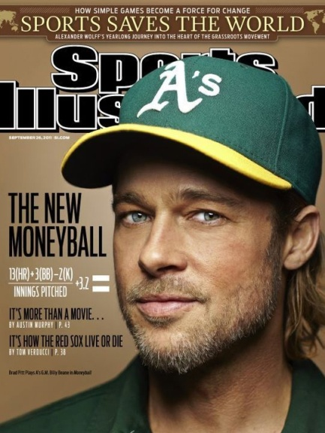
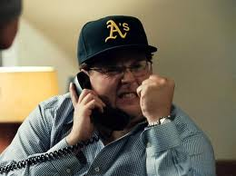
Moneyball—a Breakthrough in 2003

Slide 8
The Demand Side
The stakes have grown dramatically
$50—$100 million decisions are commonplace
Winning (Efficiently) Drives Profitability
Better player personnel decisions promote winning

Slide 9
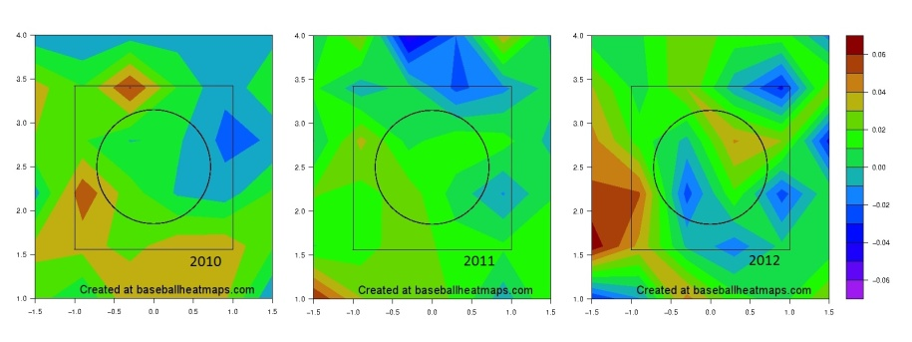
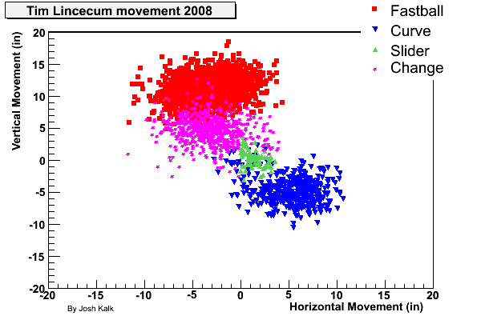
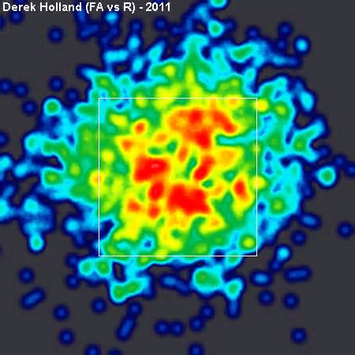
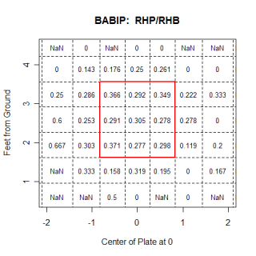
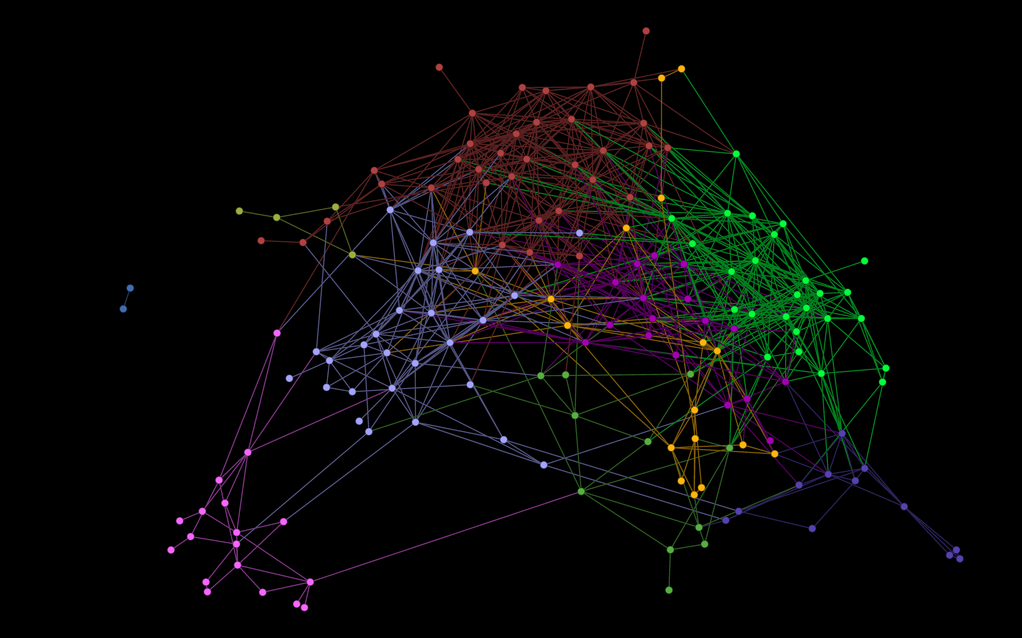
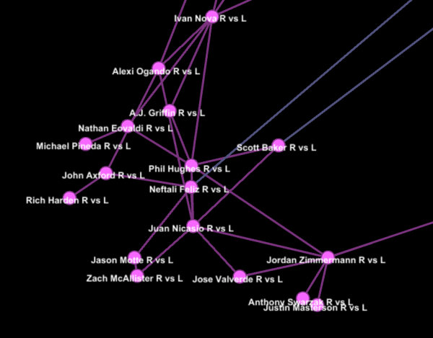
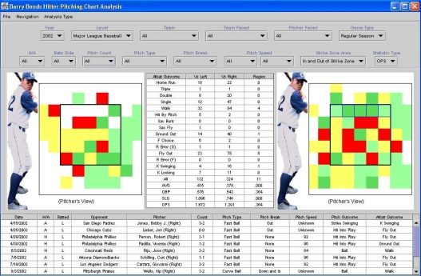
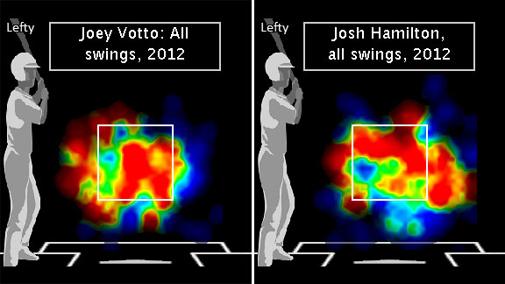
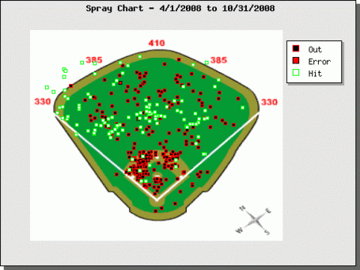
Big Data Era of Baseball Analytics

Slide 10
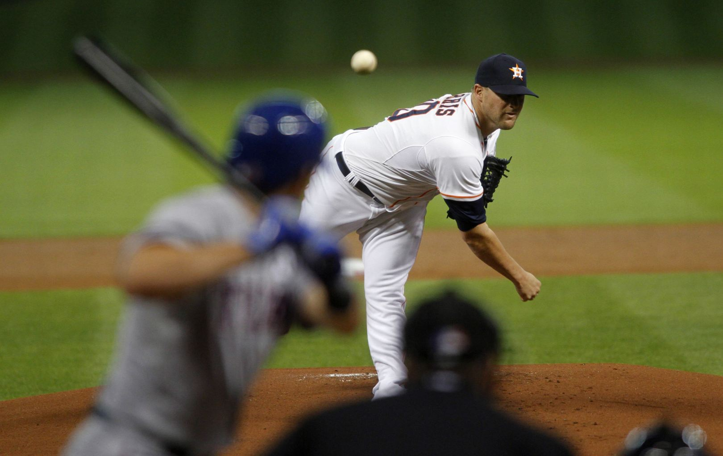
How Should a Batter-Pitcher Perform?

Slide 11
How Should a Batter-Pitcher Perform?
Starting Lineups Batting Order Pinch Hitters Relief Pitchers

Slide 12
The Problem We’re Solving
The Prevailing Approach—One-Pitcher vs. One-Batter Career Data
Small sample sizes
Timeframe is too long (full career)
No Experience = No Help
Data includes only outcomes

Slide 13
Framework—Batter vs. Pitcher
Pitcher Quality
5 Factors
Pitching Style
Hitting Style
Ballpark
Hitter Quality

Slide 14
New Data + New Technology
New Data
Pitch f/x
Hit f/x
+
Evaluating
Batter/Pitcher
Match Ups
New Technology
Graph Analytics
.

Slide 15
Framework—Batter vs. Pitcher
Pitcher Quality
5 Factors
Pitching Style
Hitting Style
Ballpark
Hitter Quality

Slide 16
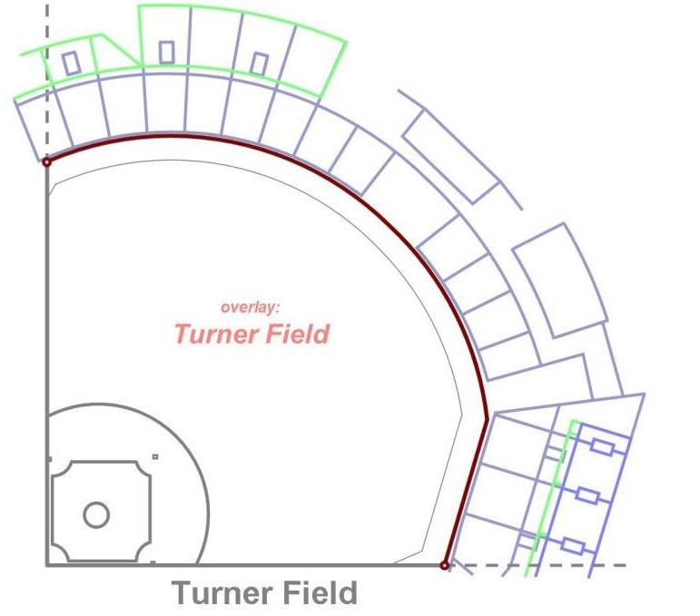
Ballpark
© Greg Rybarczyk

Slide 17
Ballpark
© Greg Rybarczyk

Slide 18
Ballpark
© Greg Rybarczyk

Slide 19
Ballpark
61% = Single
25% = Double
14% = Out

Slide 20
Ballpark
61% = Single
25% = Double
14% = Out
1.11 Total Bases

Slide 21
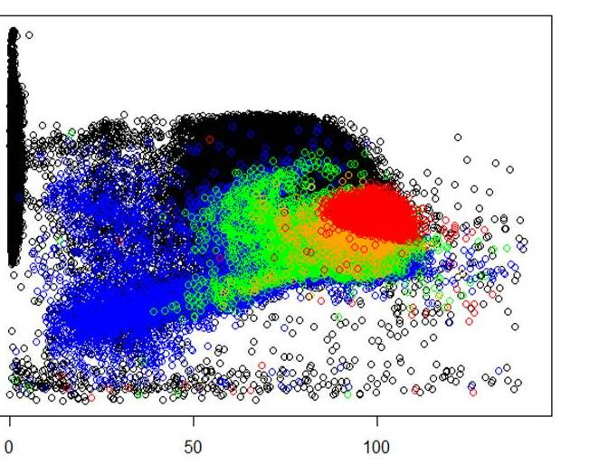
Expected Total Bases on Batted Balls
OUT
Single
Double
Triple
Homerun
Turner Field – Atlanta
Vertical Launch Angle
Batted Ball Velocity—Initial Speed off Bat

Slide 22
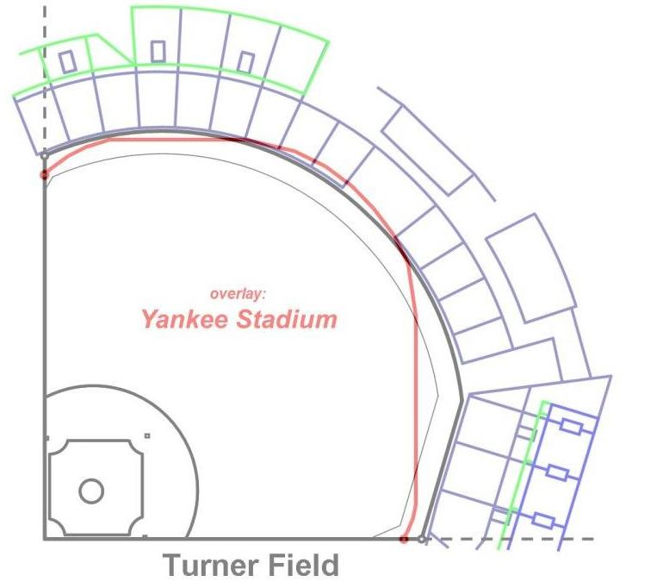
Ballpark
© Greg Rybarczyk

Slide 23
Ballpark
© Greg Rybarczyk

Slide 24
Ballpark
© Greg Rybarczyk

Slide 25
Expected Total Bases on Batted Balls
OUT
Single
Double
Triple
Homerun
Turner Field – Atlanta
Vertical Launch Angle
Batted Ball Velocity—Initial Speed off Bat

Slide 26
Expected Total Bases on Batted Balls
OUT
Single
Double
Triple
Homerun
Yankee Stadium– New York
Vertical Launch Angle
Batted Ball Velocity—Initial Speed off Bat

Slide 27
Framework—Batter vs. Pitcher
Pitcher Quality
5 Factors
Pitching Style
Hitting Style
Ballpark
Hitter Quality

Slide 28
Clustering Pitchers
Objective:
Identify pitcher similarities to form clusters of “like” pitchers
Predict hitter performance by pitcher cluster vs. individual batter/pitcher matchups

Slide 29
Clustering Pitchers
Hitters’ Questions | Model Data
What does he throw? | Top 2 Pitches Pitch Repertoire/Variety Horizontal Pitch Location Vertical Pitch Location
How hard does he throw? | Fastball Velocity
What kind of movement? | Horizontal Movement Vertical Movement
Where do his pitches come from? | Release Point
How does he like to pitch? | Swinging Strike % Zone % and Edge % Top 2-pitch Sequence

Slide 30
RH Pitcher vs. LH Batter Clusters

Slide 31
RH Pitcher vs. LH Batter Clusters

Slide 32
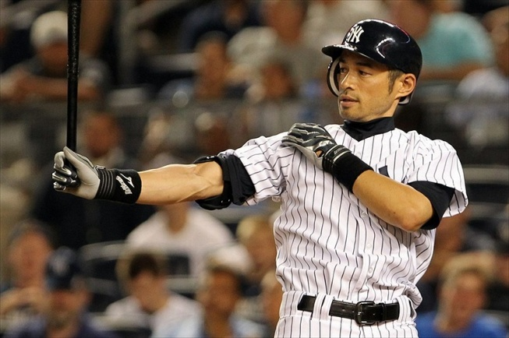
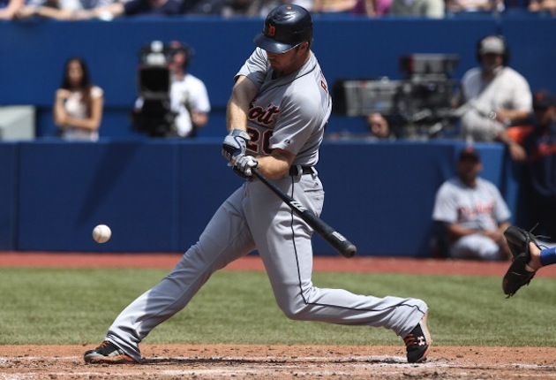
Yankees RF vs. Colorado Rockies?
Facing Right-Handed Pitcher Juan Nicasio
Ichiro Suzuki Brennan Boesch

Slide 33
Yankees RF vs. Colorado Rockies?
Facing Right-Handed Pitcher Juan Nicasio
Ichiro Suzuki Brennan Boesch
Both are 0-0 vs. Nicasio

Slide 34
Yankees Hitters—Rockies Pitchers
 | Jorge De La Rosa | Juan Nicasio | Jeff Francis | Tyler Chatwood
Ichiro Suzuki | 3-6 |  | 4-6 | 1-3
Brennan Boesch |  |  | 1-9 | 2-3

Slide 35
RHP vs. LHB Clusters

Slide 36
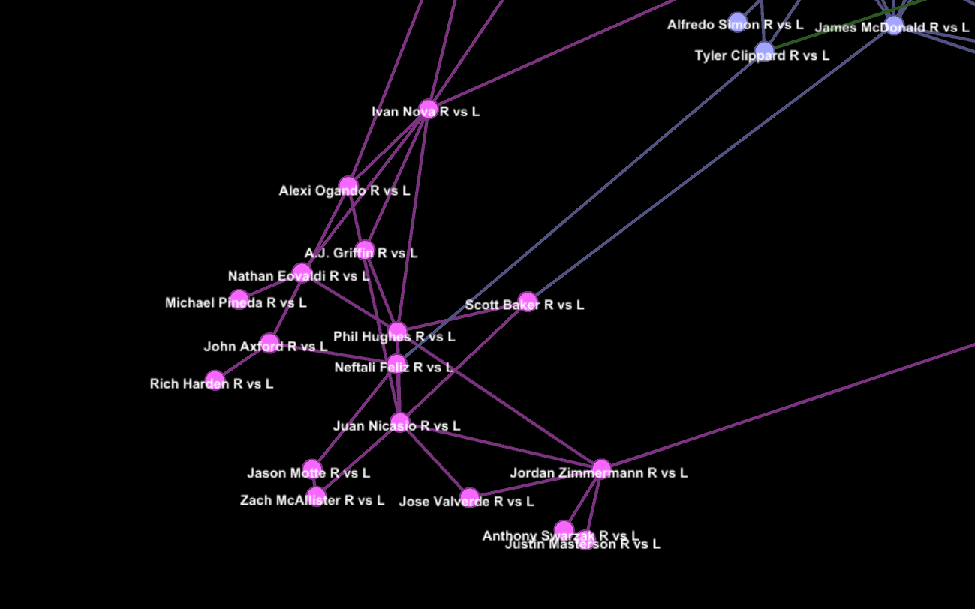
RHP vs. LHB Cluster “4”
High Velocity FB
Low Pitch Variety
Upper Half of Zone

Slide 37
RHP vs. LHB Cluster “4”
Ichiro Suzuki
0 - 6
2 - 11
1 - 3
2 - 3
0 - 6
5 - 26
2 - 5

Slide 38
RHP vs. LHB Cluster “4”
Ichiro Suzuki—30th %
0 - 6
2 - 11
1 - 3
2 - 3
0 - 6
5 - 26
2 - 5

Slide 39
RHP vs. LHB Cluster “4”
Brennan Boesch
2-7
0 - 11
3-13
2 - 3
6 -11
1 - 6
6 -23

Slide 40
RHP vs. LHB Cluster “4”
Brennan Boesch—60th %
2-7
0 - 11
3-13
2 - 3
6 -11
1 - 6
6 -23

Slide 41
Yankees Hitters—Rockies Pitchers
 | Jorge De La Rosa | Juan Nicasio | Jeff Francis | Tyler Chatwood
Ichiro Suzuki | 33 | 30 | 78 | 70
Brennan Boesch | 53 | 60 | 73 | 72

Slide 42
Framework—Batter vs. Pitcher
Pitcher Quality
5 Factors
Pitching Style
Hitting Style
Ballpark
Hitter Quality

Slide 43
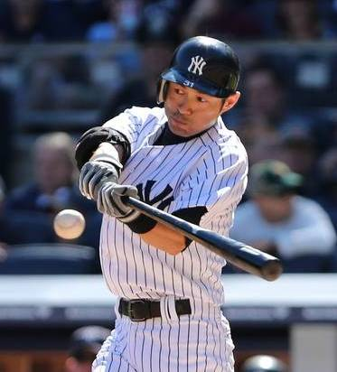
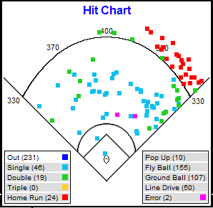
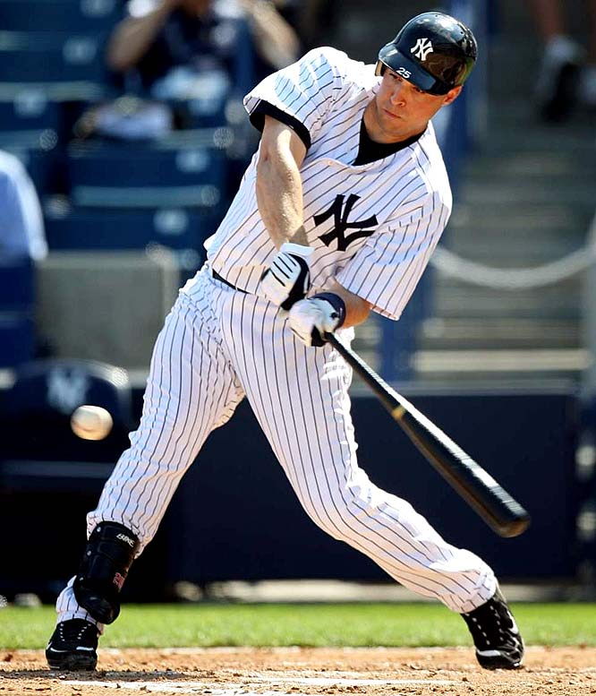
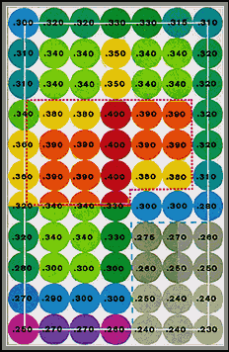
Hitting Style

Slide 44
Batter—Pitcher Match up Data Issues
Issue | Old Process | New Process
Too Literal | One-on-one | Multiple “like” pitchers
Sample Sizes | Often too small | More adequate
No prior experience | No data | Data vs. other pitchers in cluster
Timeframe | Could span 15+ yrs | Limited to more recent PAs
Performance metric | Outcomes (hit, out, etc.) | Includes batted ball diagnostics

Slide 45
The ROI of Favorable Match Ups
Use of Information/ Decisions Impacted | Runs Created or Saved
Optimizing Starting Lineup | 19 Runs
Most Favorable Pinch-Hitting Match Ups | 9 Runs
Most Favorable Relief Pitcher Match Ups | 5 Runs
 | 33 Runs
* For a “contending” team

Slide 46
The ROI of Favorable Match Ups
Use of Information/ Decisions Impacted | Runs Created or Saved
Optimizing Starting Lineup | 19 Runs
Most Favorable Pinch-Hitting Match Ups | 9 Runs
Most Favorable Relief Pitcher Match Ups | 5 Runs
 | 33 Runs
33 Runs = 3 wins
$ value of a win
$5 million*
Potential Value
$15 million in Revenue
* For a “contending” team

Slide 47
Framework—Batter vs. Pitcher
Pitcher Quality
5 Factors
Pitching Style
Hitting Style
Ballpark
Hitter Quality

Slide 48
Framework—Batter vs. Pitcher
Refining a predictive model of batter/pitcher outcomes—optimal combination of 5 factors
Validating model against actual outcomes
Compare predictive accuracy to historical “one-to-one” expectations
Continue to fine-tune model, incorporating new data daily

Slide 49
Fine-Tuning Model Input Weights

Slide 50
Fine-Tuning Model Input Weights

Slide 51
END

