Slide 1


Exascale Co-Design Paths
SAND2014-3277P
James Ang, Ph.D., Senior Manager (acting)
Extreme-scale Computing Group
Sandia National Laboratories
Albuquerque, NM
Random Access Talk
Salishan Conference on High Speed Computing
Gleneden Beach, OR
April 23, 2014
1

Slide 2

ASCI provided critical mass to the
Attack of the Killer Micros
Strategy based on integration of commodity computing components into large scale MPPs
ASC(I) rode the Golden Era of Moore’s Law + Dennard Scaling to increase HPC performance from Tera-scale to Peta-scale
MICROS .
Credit – Eugene Brooks, LLNL
Notes:
CMOS FET microprocessors Killed Bipolar Junction Vector Processors

Slide 3
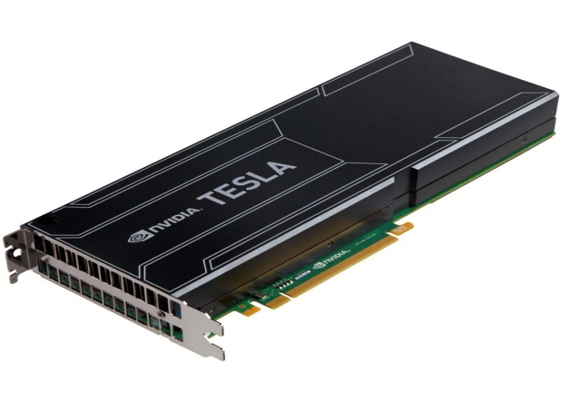
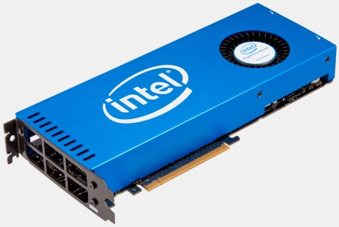
Commodity Computer Technology has changed
We are in the midst of the 2nd Era of commodity processors
Commercial workloads benefit from performance increases of multi-core processors, but most of the ASC Mission-driven Applications do not
The strategy of creating supercomputers from the integration of COTS computing components may be breaking down
Notes:
The 2nd Era of Commodity microprocessors – Since the end of Dennard Scaling, we have seen the commodity computing ecosystem depart further from our needs for HPC
Commercial workloads benefit from performance increases of multi-core processors, but most engineering analysis and multi-physics scientific applications are unable to exploit the theoretical performance potential

Slide 4
Three Co-design Paths
Reactive
Proactive
Holistic

Slide 5
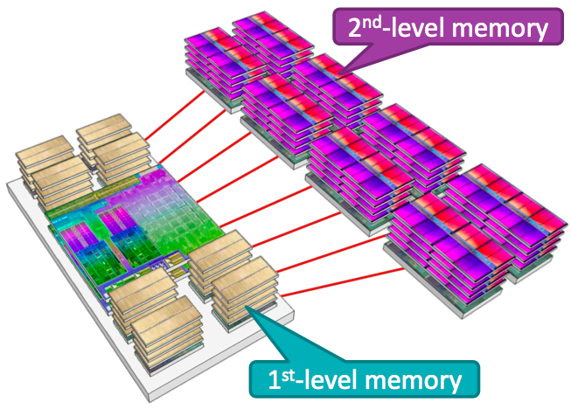
Reactive Co-Design
We proceed with the status quo – integrate commodity computing components into large scale MPPs
ASC’s Advanced Technology Development and Mitigation (ATDM) effort supports reactive co-design – Apps and Sys SW
Examples of technology we are reacting to:
  Multi and Many Core Processors
  Heterogeneous Processors
  Multi-tiered Memory
  Commodity Interconnects
AMD Two Level Memory Concept
Notes:
Continue to port our application portfolio to new commodity advanced architectures using component technologies that were originally designed for other markets
Commodity computing may also soon adopt multi-level memory
We need an objective analysis of our application portfolio to determine what fraction of our code base will perform well on multi-level memory
The latest indications are that the commodity computing ecosystem is going to adopt two level or multi level memory
As with GP-GPU processors, we need to perform an objective analysis of our application portfolio to determine what fraction of our code base is a good fit for multi-level memory

Slide 6
Proactive Co-Design
If the DOE Exascale Initiative materializes, resources and collaborations can directly influence the design of future commodity computing components and technology
Co-designed COTS components can be integrated to address other application areas such as graph analytics that are also not met with status quo COTS components
Current and planned FF & DF projects establish a runway for future COTS
IBM/Columbia SiPhotonics Concept
Notes:
These COTS computing components can be integrated into systems at all scales: from workstations to departmental servers and DOE's largest Exascale systems

Slide 7
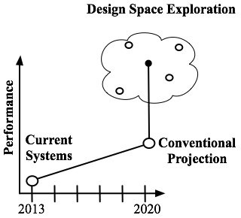
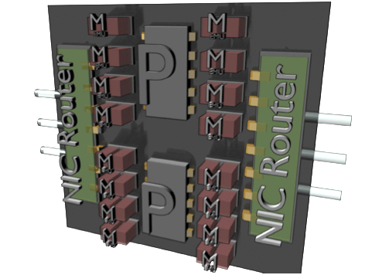
Holistic Co-Design
The DOE Exascale initiative can also directly influence the design of future special purpose HPC computing components
Leverage the System on Chip (SoC) Ecosystem to develop computing technology designs that are unconstrained by product roadmaps
Develop prototype testbeds
  Can lead directly to SoC products
  Or be adopted by the COTS computing ecosystem
Sandia's Xcaliber
Node Concept
Sandia's XGC Point Design/
Design Space Exploration
Notes:
The SoC path leverages IP “Blocks” EDA tools, Foundry Capabilities to develop innovative computing technology designs.

Slide 8
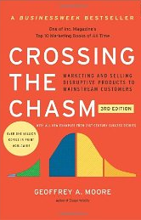
Proactive versus Holistic Co-Design?
We understand it is challenging for technology to transition from R&D into Product
  Product Roadmaps have a lot of inertia
  Given the difficulty in adopting new technology from within, how much influence can DOE have?
Holistic Co-Design and a DOE SoC strategy can help Bridge the Chasm
  Co-Design Analysis Tools
  Proof of concept technology demonstrators
  Lower the risk of adoption by COTS computing component manufacturers
Notes:
The SoC strategy can produce advanced architecture designs that can also be either directly commercialized, or adopted by the COTS computing component community.

Slide 9



jaang@sandia.gov

