Slide 1
Are We Exploring the Right Enabling Technologies to Support End Applications in the Push to Exascale?
Robert Webster, Los Alamos National Laboratory
Abstract:
Modern applications in use within the Defense Programs mission of NNSA can greatly benefit from the development and use of exascale-class computing. To take advantage of such computing, the applications will have to evolve to fit the modern architectures required to achieve such a scale in computing. Because of the long development time for these applications, much discussion and thought is being given to programming models, and the role that co-design could have in developing a hardware and software model that minimizes the cost of moving applications between changing and potentially divergent architectures, hiding data movement, exposing (or hiding) power management, and the like. Perhaps instead, the community should target the requirement for an application rather than the application itself, and thus target reducing the time to develop an application as opposed to the cost of maintaining and moving the application between architectures. Some motivational examples from the past are discussed, as well as the role of continued application development in the path to exascale.

Slide 2
A large “fixed cost” of personnel for NNSA Apps opens opportunities for bridging architectures
The ASC right-size effort establishes the scale of effort necessary to maintain nuclear weapon simulation competence.
The manner in which present day decisions are made limits the number and type of options available to stockpile stewardship
The available options are nearly exhausted
Desirable options require improved physics
We don’t know what the required physics improvement is!!!
At present, it takes about a decade to build and deploy a weapon simulation tool.
We need to iterate fundamental physics and modeling in our codes more quickly than is possible at present.
An appropriate target is 4 years to develop a weapon performance app.
It is necessary that the app does not significantly lag the hardware.
For NNSA Defense programs the cost of rewriting the applications is a secondary issue, the time to rewrite the applications is paramount!

Slide 3
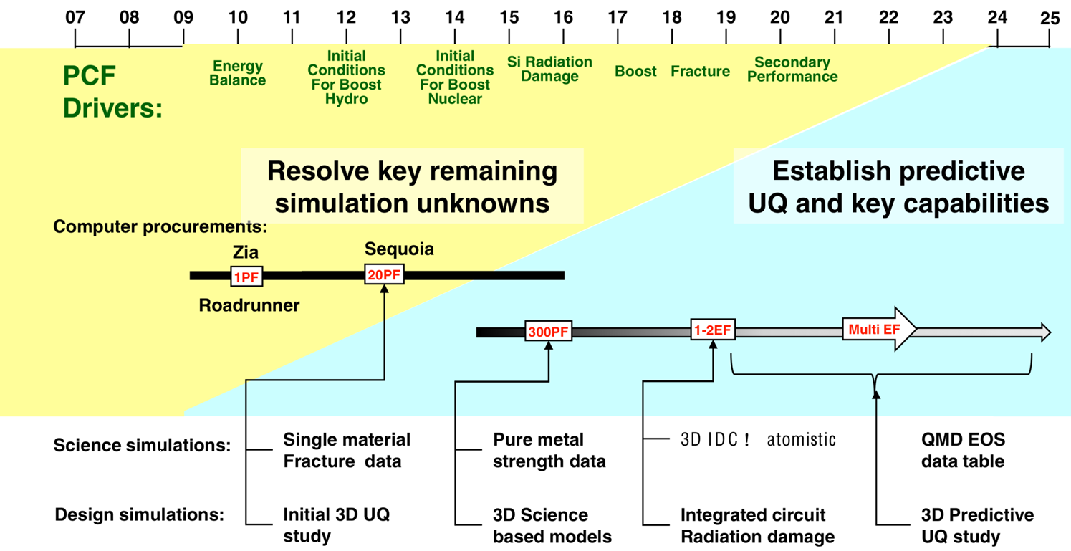
Stockpile requirements are driving need for greater understanding, requiring Exascale to establish predictive 3D UQ
Nuclear Weapons requirements drive the need for greater understanding, and 3D predictions with quantified uncertainty
Cielo
3D IC atomistic

Slide 4
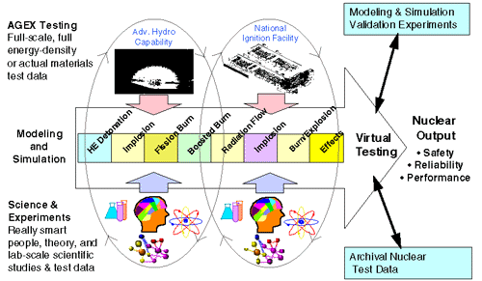
We have learned a lot since the Accelerated Strategic Computing Initiative (circa1996)
Petascale allows 3D simulation or perhaps full physics, but not both
Simply scaling up our apps does not solve Boost
The basic philosophy is still being pursued.
Changes in computing use cases resolved some of the worries of the day:
Checkpoint/Restart
Graphics demands

Slide 5
Decisions regarding nuclear weapons are still made by a combination of expert judgment and simulation
Decision
Expert Judgment
Simulation
Nuclear Test Experience
Experiment
(UGTs, AGEX, …)
High Performance Computing
Today:
Certify/assess with scale dependent physics.
=> Requires proximity to Nuclear Tests
(ok for limited SFI’s, LEP’s, etc.)
“Expert Judgment” informed by NTS experience
Tomorrow:
Codes have scale independent physics models
=> Expanded domain of calculation “validity”
“Expert Judgment” developed from
AGEX + New Codes + Nuclear Test History

Slide 6
Goal — to enable decisions based upon reliable predictions in experimentally inaccessible regimes!
Ability to develop “expert judgment”
Archived
Nuclear Testing
Accessible
Experiments
AGEX: DAF, DARHT,
LANSCE, MaRIE, NIF, Z Machine…
Query
Discovery
Physics Codes invoking scale independent model equations
Research Prototypes
Development
Production Environment
Weapon Simulation
?
Production Computing
?
Development
Dates are Notional
Prototype Exascale
Exascale
2008
2010
2012
2015
2018
2020
2022
2025

Slide 7
Present Day Algorithms scale very poorly => Not suitable for our “physics code”
Suppose today’s algorithm as applied at exascale has:
Weak Scaling
1000x performance
1000x memory ; )
I/O that keeps up…
Existing Navier Stokes Solvers will achieve 5.6 times today’s resolution in 3D
That does cross an interesting physical scale length, but…
The other physics in our codes may not be valid at that scale,
We go from resolving 2 decades of inertial range to 2 ½ .
(Non-hydro physics can scale even more poorly!)
We are studying new algorithms that can better take advantage of the scale of computation, such as the High Order/Low Order radiation transport model in development at LANL
May lose determinism
Checkpoint requirements can become much smaller
Bottom line, only marginal discovery remains with the brute force approach

Slide 8
We use HPC to perform scientific discovery through complex deductions
“In July 2003, Raymond Orbach, Director of the DOE Office of Science, testified before the U.S. House of Representatives Committee on Science. He said
The tools for scientific discovery have changed. Previously, science had been limited to experiment and theory as the two pillars for investigation of the laws of nature. With the advent of what many refer to as “Ultra-Scale” computation, a third pillar, simulation, has been added to the foundation of scientific discovery.”
This type of scientific discovery REQUIRES re-development of the high end applications
Such re-development constitutes the hypothesis in play
Rapid re-development is the key to scientific leadership
Rapid re-development makes evolution look like revolution
Quote from GETTING UP TO SPEED: THE FUTURE OF SUPERCOMPUTING
THE NATIONAL ACADEMIES PRESS - 2005

Slide 9
We need a revolution in app design, lots of possibilities exist
Non-deterministic computing
Smaller checkpoints and graphics files
New algorithms
Can also impact the time integration scheme
Change of the primitive state variables stored
Typically this is a blank sheet startup
Potential impact on memory access coherence
Move from THIS to THIS
New integrated App
New Integrated App
Today
Today
4 years?
4 years?
4-8 years?
New Platform
New Platform
The total App code base at LANL is only 5-10M SLOC, we can afford to and must replace it.

Slide 10
But, the community seems to be driven towards revolutionary CS
Quoting John West from “There is a right way, and a wrong way, to exascale | insideHPC.com”
“ [snip] My own reason for agreeing with this point of view is that while, yes, we can build petascale machines, we are getting between 1% and 5% of peak on general applications. This is what an evolutionary model gets you. We are well past the point when a flop is worth more than an hour of application developer’s time. We need to encourage the development of integrated hardware/software systems that help programmers write correct, large scale applications that get 15, 20, or even 30% of peak performance. To mangle Hamming, the purpose of supercomputing is discovery, not FLOPS.”
There is a pervasive tendency to fear the cost of application rewrite, or wasted flop efficiency
To little attention to the role of memory in the applications.
If our “apps” programmers could get significant flops from a toaster they’d program it. The stockpile was designed with explicit memory management, overlays and significant coding in machine and assembly language.

Slide 11
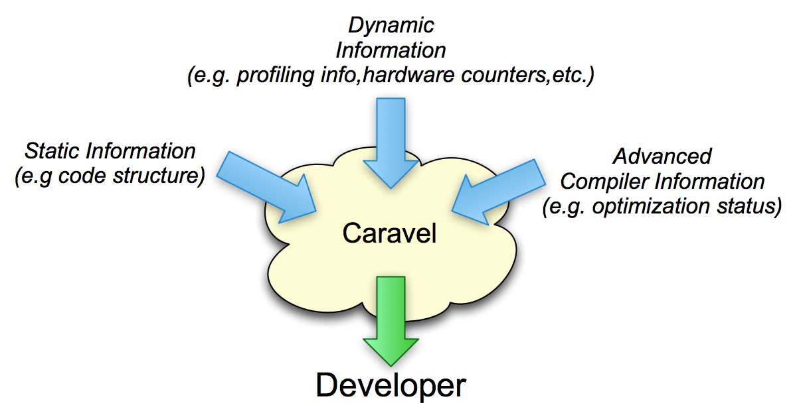
Caravel: Program-structure-based exploration and performance analysis
Compilers promote a “fire-and-forget” mentality
Details left unexplained – a black box, useful information lost
Difficult to wade through a complex code and its characteristics (compiler feedback, performance, source, etc.)
Goal: Give developers better capabilities
Support code-centric queries
Performance-centric details
Correlate cross-tool results
Embedded feedback
Concepts developed in the context of xRAGE, an ASC integrated code

Slide 12
So what do the Apps need?
Yes we need most of the current efforts:
Domain Specific Languages (like Liszt) look promising
RAS will be needed regardless of programming model
Resiliency will be easier if hidden
Program analysis tools
Programming models for hierarchies
Not clear that :
We need languages to hide architectures
Checkpointing is a show stopper
What do we need that isn’t evident at the Apps end yet?
Simulators so that we can design to the future architecture
Memory compression schemes
Variable precision arithmetic
Debugging tools for non-deterministic computation
Test and build systems that span sites, architectures, and scales
Memory is king for present approaches to discovery for NNSA/DP

Slide 13
A large “fixed cost” of personnel for NNSA Apps opens opportunities for bridging architectures
The ASC right-size effort establishes the scale of effort necessary to maintain nuclear weapon simulation competence.
The manner in which present day decisions are made limits the number and type of options available to stockpile stewardship
The available options are nearly exhausted
Desirable options require improved physics
We don’t know what the required physics improvement is!!!
At present, it takes about a decade to build and deploy a weapon simulation tool.
We need to iterate fundamental physics and modeling in our codes more quickly than is possible at present.
An appropriate target is 4 years to develop a weapon performance app.
It is necessary that the app does not significantly lag the hardware.
For NNSA Defense programs the cost of rewriting the applications is a secondary issue, the time to rewrite the applications is paramount!

