Slide 1
From Here to ExaScale
Challenges and Potential Solutions
Bill Dally
Chief Scientist, NVIDIA
Bell Professor of Engineering, Stanford University

Slide 2
Two Key Challenges
Programmability
  Writing an efficient parallel program is hard
  Strong scaling required to achieve ExaScale
  Locality required for efficiency
Power
  1-2nJ/operation today
  20pJ required for ExaScale
  Dominated by data movement and overhead
Other issues – reliability, memory bandwidth, etc… are subsumed by these two or less severe

Slide 3
ExaScale Programming

Slide 4
Fundamental and Incidental Obstacles to Programmability
Fundamental
  Expressing 10⁹ way parallelism
  Expressing locality to deal with >100:1 global:local energy
  Balancing load across 10⁹ cores
Incidental
  Dealing with multiple address spaces
  Partitioning data across nodes
  Aggregating data to amortize message overhead

Slide 5
The fundamental problems are hard enough. We must eliminate the incidental ones.

Slide 6
Very simple hardware can provide
Shared global address space (PGAS)
  No need to manage multiple copies with different names
Fast and efficient small (4-word) messages
  No need to aggregate data to make Kbyte messages
Efficient global block transfers (with gather/scatter)
  No need to partition data by “node”
  Vertical locality is still important

Slide 7
A Layered approach to Fundamental Programming Issues
Hardware mechanisms for efficient communication, synchronization, and thread management
  Programmer limited only by fundamental machine capabilities
A programming model that expresses all available parallelism and locality
  hierarchical thread arrays and hierarchical storage
Compilers and run-time auto-tuners that selectively exploit parallelism and locality

Slide 8
Execution Model
Object
Thread
A
B
Global Address Space
A
Abstract Memory Hierarchy
Bulk Xfer
B
B
Load/Store
Active Message

Slide 9
Thread array creation, messages, block transfers, collective operations – at the “speed of light”

Slide 10
Language Describes all Parallelism and Locality – not mapping
forall molecule in set { // launch a thread array
forall neighbor in molecule.neighbors { // nested
forall force in forces {
molecule.force =
reduce_sum(force(molecule, neighbor))
}
}
}

Slide 11
Language Describes all Parallelism and Locality – not mapping
compute_forces::inner(molecules, forces) {
tunable N ;
set part_molecules[N] ;
part_molecules = subdivide(molecules, N) ;
forall(i in 0:N-1) {
compute_forces(part_molecules) ;
}

Slide 12
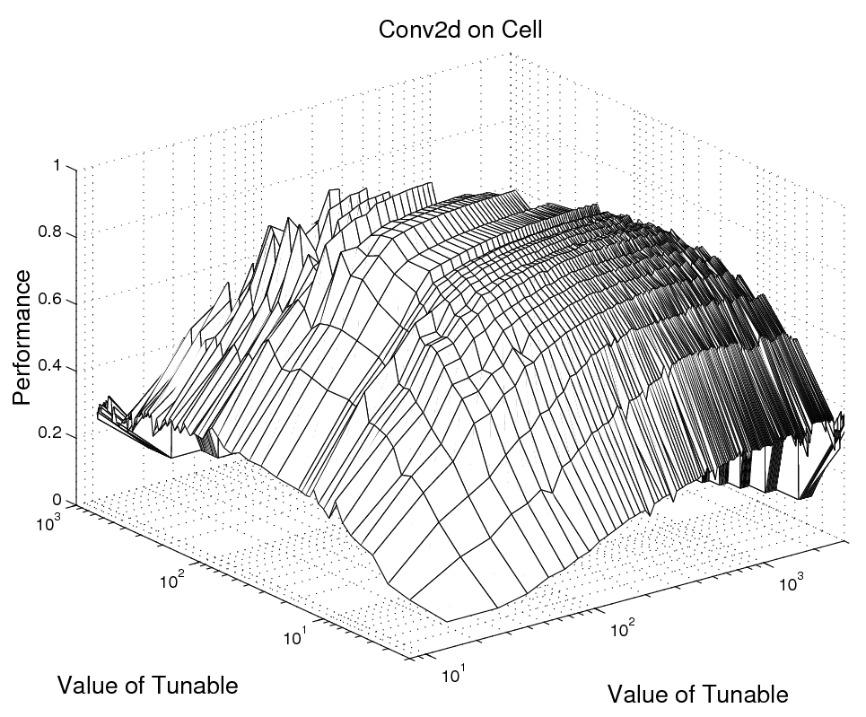
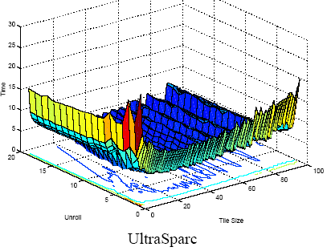
Autotuning Search Spaces
Execution Time of Matrix Multiplication for Unrolling and Tiling
Architecture enables simple and effective autotuning
T. Kisuki and P. M. W. Knijnenburg and Michael F. P. O'Boyle
Combined Selection of Tile Sizes and Unroll Factors Using Iterative Compilation.
In IEEE PACT, pages 237-248, 2000.

Slide 13
Performance of Auto-tuner
 |  | Conv2D | SGEMM | FFT3D | SUmb
Cell | Auto | 96.4 | 129 | 57 | 10.5
 | Hand | 85 | 119 | 54
Cluster | Auto | 26.7 | 91.3 | 5.5 | 1.65
 | Hand | 24 | 90 | 5.5
Cluster of PS3s | Auto | 19.5 | 32.4 | 0.55 | 0.49
 | Hand | 19 | 30 | 0.23
Measured Raw Performance of Benchmarks: auto-tuner vs. hand-tuned version in GFLOPS.
For FFT3D, performances is with fusion of leaf tasks.
SUmb is too complicated to be hand-tuned.

Slide 14
What about legacy codes?
They will continue to run – faster than they do now
But…
  They don’t have enough parallelism to begin to fill the machine
  Their lack of locality will cause them to bottleneck on global bandwidth
As they are ported to the new model
  The constituent equations will remain largely unchanged
  The solution methods will evolve to the new cost model

Slide 15
The Power Challenge

Slide 16
Addressing The Power Challenge (LOO)
Locality
  Bulk of data must be accessed from nearby memories (2pJ) not across the chip (150pJ) off chip (300pJ) or across the system (1nJ)
  Application, programming system, and architecture must work together to exploit locality
Overhead
  Bulk of execution energy must go to carrying out the operation not scheduling instructions (100x today)
Optimization
  At all levels to operate efficiently

Slide 17
Locality

Slide 18
  The High Cost of Data Movement
  Fetching operands costs more than computing on them
20mm
64-bit DP
20pJ
26 pJ
256 pJ
16 nJ
DRAM
Rd/Wr
256-bit
buses
500 pJ
Efficient
off-chip link
50 pJ
256-bit access
8 kB SRAM
1 nJ
28nm

Slide 19
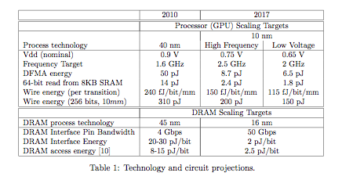
Scaling makes locality even more important

Slide 20
Its not about the FLOPS
Its about data movement
Algorithms should be designed to perform more work per unit data movement.
Programming systems should further optimize this data movement.
Architectures should facilitate this by providing an exposed hierarchy and efficient communication.

Slide 21
Locality at all Levels
Application
  Do more operations if it saves data movement
  E.g., recompute values rather than fetching them
Programming system
  Optimize subdivision
  Choose when to exploit spatial locality with active messages
  Choose when to compute vs. fetch
Architecture
  Exposed storage hierarchy
  Efficient communication and bulk transfer

Slide 22
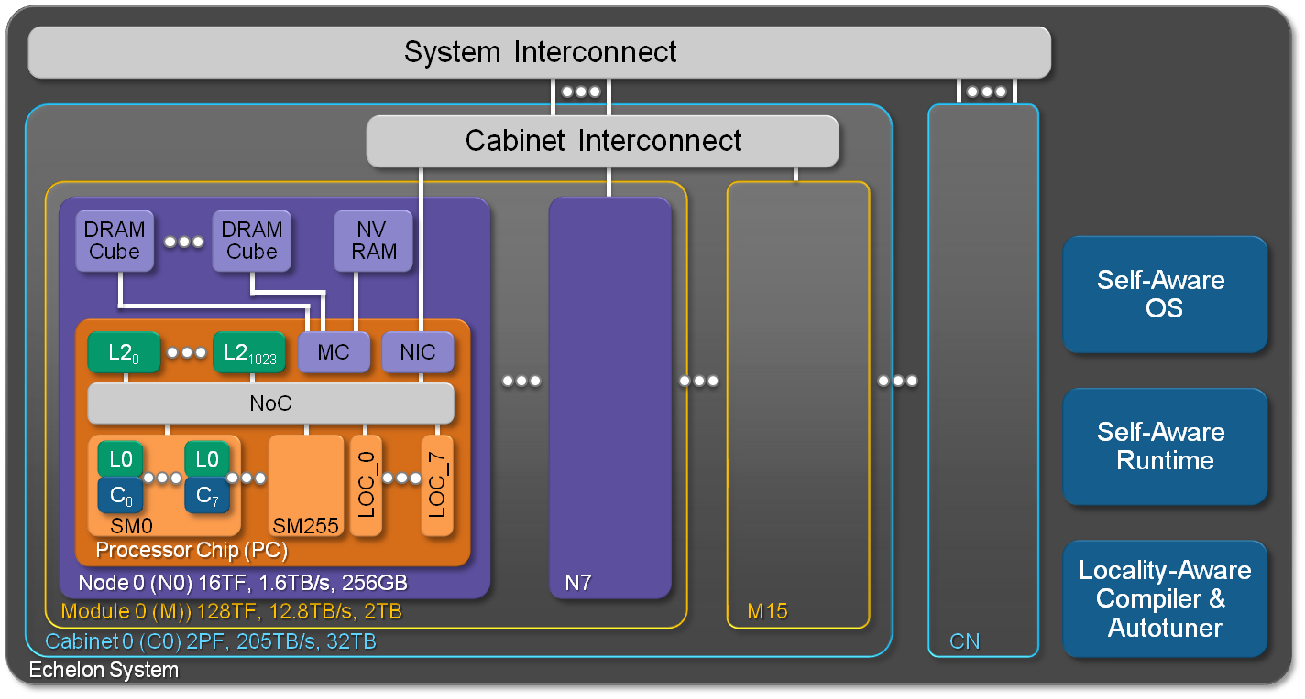
System Sketch

Slide 23
Echelon Chip Floorplan
17mm
10nm process
290mm²

Slide 24
Overhead

Slide 25
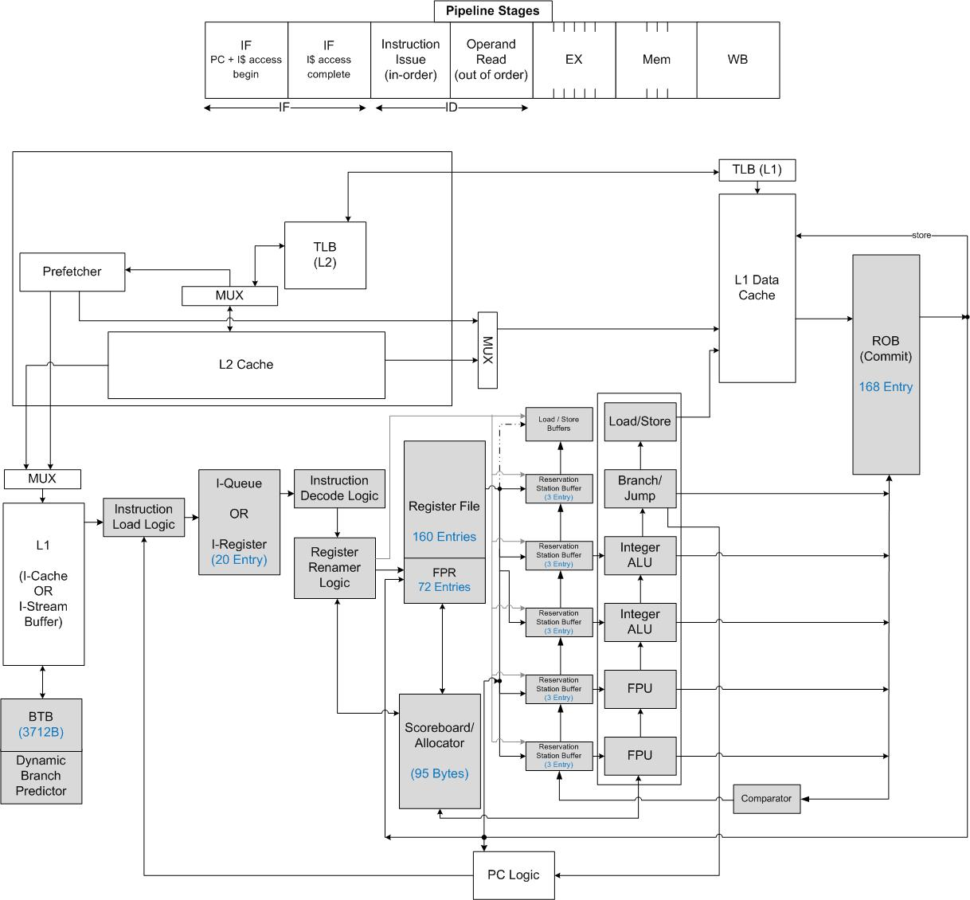
An Out-of-Order Core
Spends 2nJ to schedule a 50pJ FMA (or an 0.5pJ integer add)
Notes:
May want to make a better image if time permits

Slide 26
SM Lane Architecture

Slide 27
Optimization

Slide 28
Optimization needed at all levels
Guided by where most of the power goes
Circuits
  Optimize V_{DD}, V_{T}
  Communication circuits – on-chip and off
Architecture
  Grocery list approach – know what each operation costs
  Example – temporal SIMT
    An evolution of the classic vector architecture
Programming Systems
  Tuning for particular architectures
  Macro-optimization
Applications
  New methods driven by the new cost equation

Slide 29
On-Chip Communication Circuits

Slide 30

Temporal SIMT
Existing Single Instruction Multiple Thread (SIMT) architectures amortize instruction fetch across multiple threads, but:
  Perform poorly (and energy inefficiently) when threads diverge
  Execute redundant instructions that are common across threads
Solution: Temporal SIMT
  Execute threads in thread group in sequence on a single lane
    Amortize fetch
  Shared registers for common values
    Scalarization – amortize execution

Slide 31
Solving the Power Challenge – 1, 2, 3

Slide 32
Solving the ExaScale Power Problem

Slide 33
Log Scale
Bars on top are larger than they appear

Slide 34
The Numbers (pJ)

Slide 35

CUDA GPU Roadmap
Maxwell
16
14
12
10
8
DP GFLOPS per Watt
Kepler
6
4
Fermi
2
Tesla
2007
2009
2011
2013
Jensen Huang’s Keynote at GTC 2010
Notes:
Tesla = .4
Fermi = 1.6
Kepler = 4.8
Maxwell = 14.4

Slide 36
Investment Strategy

Slide 37

Do we need exotic technology?
Semiconductor, optics, memory, etc…

Slide 38
Do we need exotic technology?
Semiconductor, optics, memory, etc…
No, but we’ll take what we can get
… and that’s the wrong question

Slide 39
The right questions are:
Can we make a difference in core technologies like semiconductor fab, optics, and memory?
What investments will make the biggest difference (risk reduction) for ExaScale?

Slide 40
Can we make a difference in core technologies like semiconductor fab, optics, and memory?
No, there is a $100B+ industry already driving these technologies in the right direction.
The little we can afford to invest (<$1B) won’t move the needle (in speed or direction)

Slide 41
What investments will make the biggest difference (risk reduction) for ExaScale?
Look for long poles that aren’t being addressed by the data center or mobile industries.

Slide 42
What investments will make the biggest difference (risk reduction) for ExaScale?
Programming systems – they are the long pole of the tent and modest investments will make a huge difference.
Scalable, fine-grain, architecture –communication, synchronization, and thread management mechanisms needed to achieve strong scaling – conventional machines will stick with weak scaling for now.

Slide 43
Summary

Slide 44
ExaScale Requires Change
Programming Systems
  Eliminate incidental obstacles to parallelism
    Provide global address space, fast, short messages, etc…
  Express all of the parallelism and locality - abstractly
    Not the way current codes are written
  Use tools to map these applications to different machines
    Performance portability
Power
  Locality: In the application, mapped by the programming system, supported by the architecture
  Overhead
    From 100x to 2x by building throughput cores
  Optimization
    At all levels
The largest challenge is admitting we need to make big changes.
  This requires investment in research, not just procurements

